Slide 1

How to draw a nose
www.tinkelstar.be

Slide 2
NOSE DRAWING LESSONS
By tinkelstar.be
1…

Slide 3
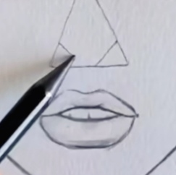
1…
www.tinkelstar.be

Slide 4
NOSE DRAWING LESSONS
By tinkelstar.be
2…

Slide 5
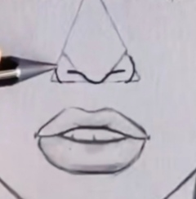
www.tinkelstar.be
2…

Slide 6
NOSE DRAWING LESSONS
By tinkelstar.be
3…

Slide 7
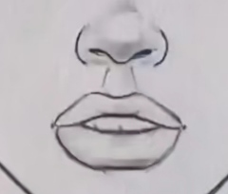
www.tinkelstar.be
3…

Slide 8
…The End…
www.tinkelstar.be

